Slide 1
LinkedIn Job Listings Project: Data Analyst
Kaggle Dataset Highlighting Data Analyst Job Postings From May 2022 – Nov 2022 Matthew Buonocore

Slide 2
Project Goals
Establish which companies are hiring for multiple positions/postings
Discover the breakdown of onsite, hybrid and remote positions
Evaluate differences in posted salary information
Utilize location data to see where the “hiring hotspots” are
Highlight any hiring trends over time

Slide 3
Project Description
Conducted data wrangling, cleaning and analysis using Python in Visual Studio Code
Concatenated two datasets with Pandas to create one dataset which encompassed all the North American data
Plotted stacked bar charts and histograms using Matplotlib
Utilized GeoPy Geocoding Library to convert location names to coordinates
Compiled additional visualizations using Tableau

Slide 4
Dataset Overview
Datasets Used:
linkedin-jobs-usa.csv & linkedin-jobs-canada.csv
Column Details
title: Job title
company: Name of the company
description: Description of the job and company
onsite_remote: Location where the employee will be working from
salary: Salary for the job. May be yearly or hourly. In most cases, it is a range from min to max
location: Where the company with the opening role is located
criteria: Job requirements like experience, employment type, etc
posted_date: The date the job was posted
link: The URL to the job
https://www.kaggle.com/datasets/cedricaubin/linkedin-data-analyst-jobs-listings?select=linkedin-jobs-usa.csv

Slide 5
Companies Hiring Multiple Positions/Postings
PayPal – 499
SSENSE – 133
Synechron – 110
Insight Global – 106
Diverse Lynx – 101
Citi – 76
theScore – 72
Circle K – 72
Onlia – 72
Agility Partners – 72

Slide 6
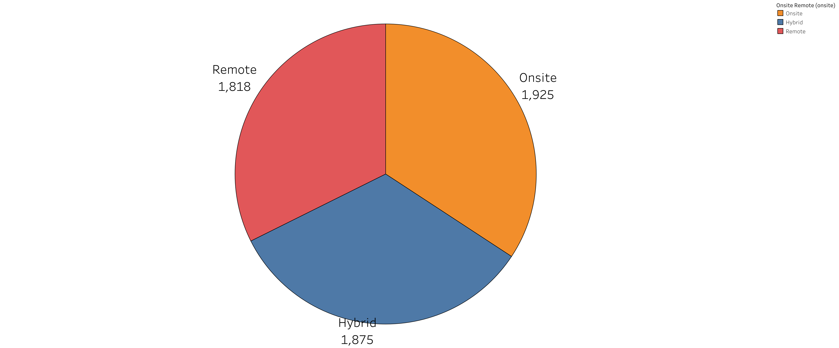
Breakdown Of Position Types
Onsite – 1925 postings (34.3%)
Hybrid – 1875 postings (33.4%)
Remote – 1818 postings (32.4%)

Slide 7
Salary Evaluation
Only 17% of the job postings had information about salary
Most of the postings that did have salary info was in a range (i.e., $75,000 - $80,000 annually or $40 - $50 hourly)
Split that data into two separate columns and converted all into an annual amount
Lower end of the range annual
Higher end of the range annual

Slide 8
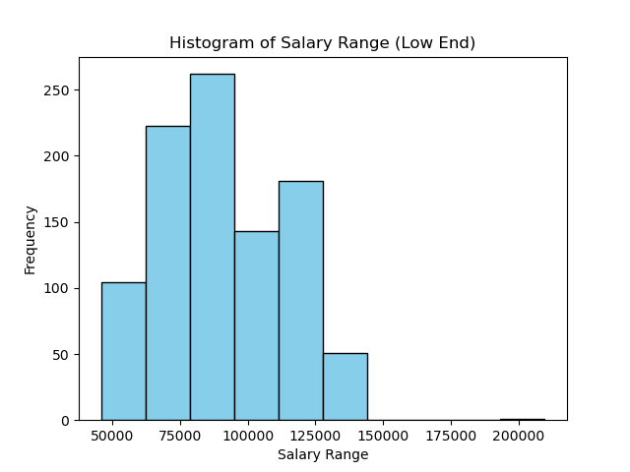
Salary Evaluation
Lower End Salary Range
Mean $89,586
Std $24,969
Min $45,760
25% $70,000
50% $83,200
75% $104,000
Max $209,757

Slide 9
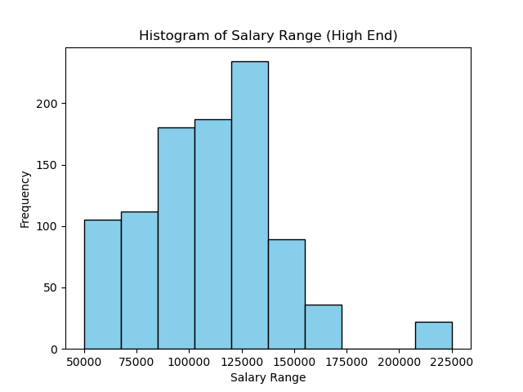
Salary Evaluation
Higher End Salary Range
Mean $109,429
Std $32,892
Min $49,920
25% $90,000
50% $110,000
75% $124,800
Max $225,295

Slide 10
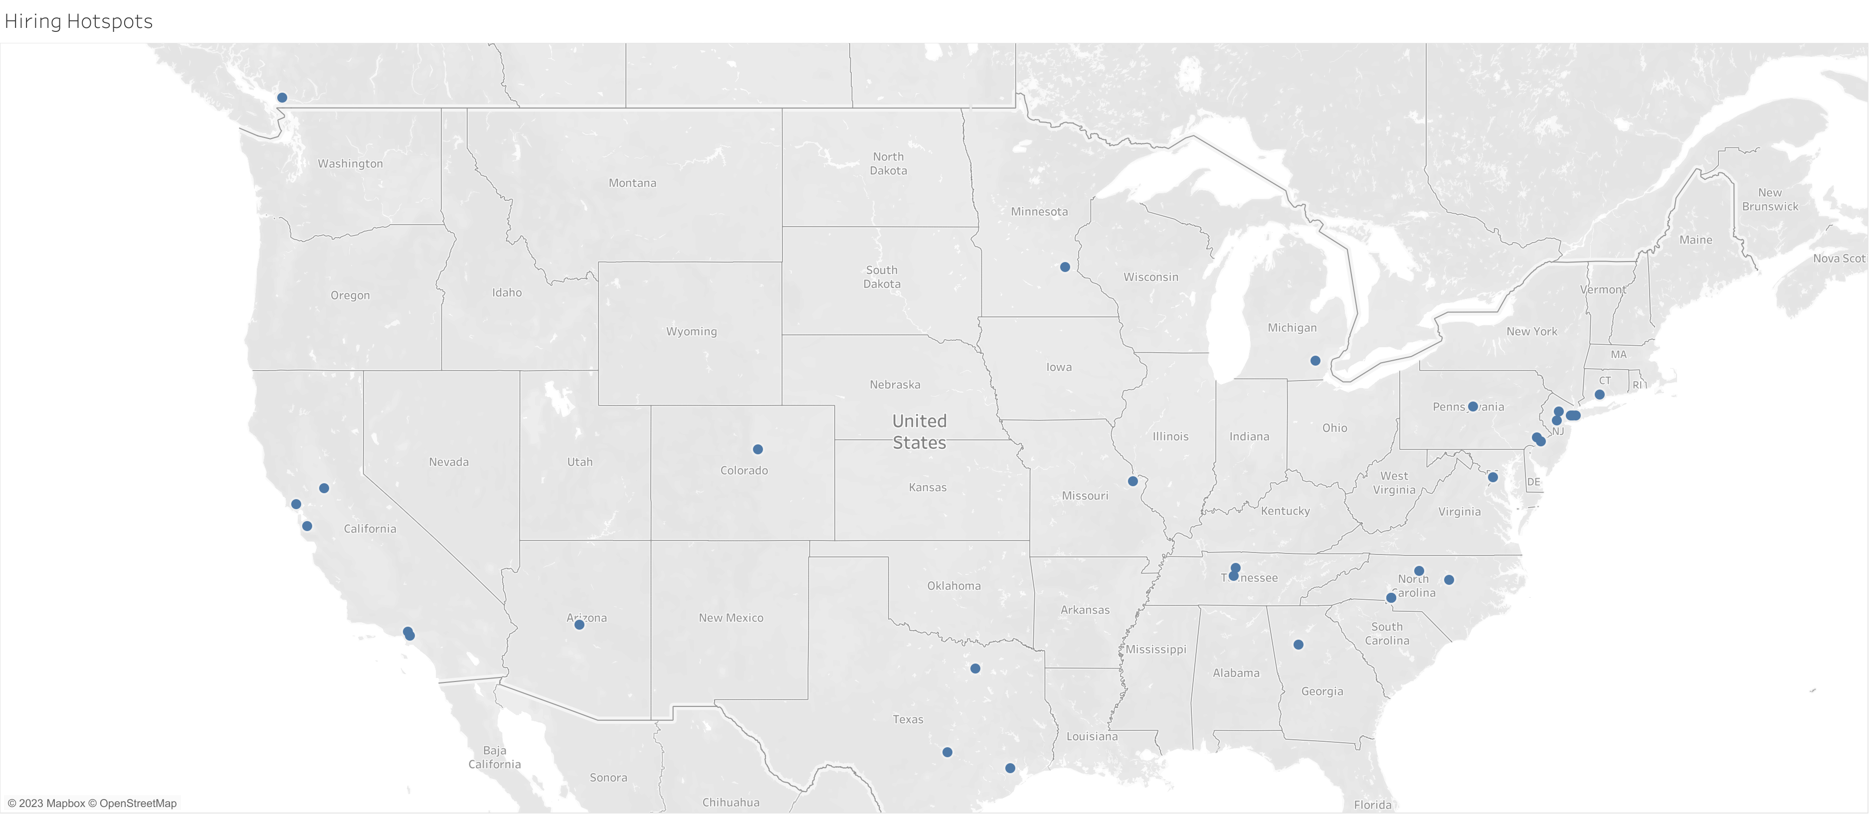
Hiring Hotspots

Slide 11
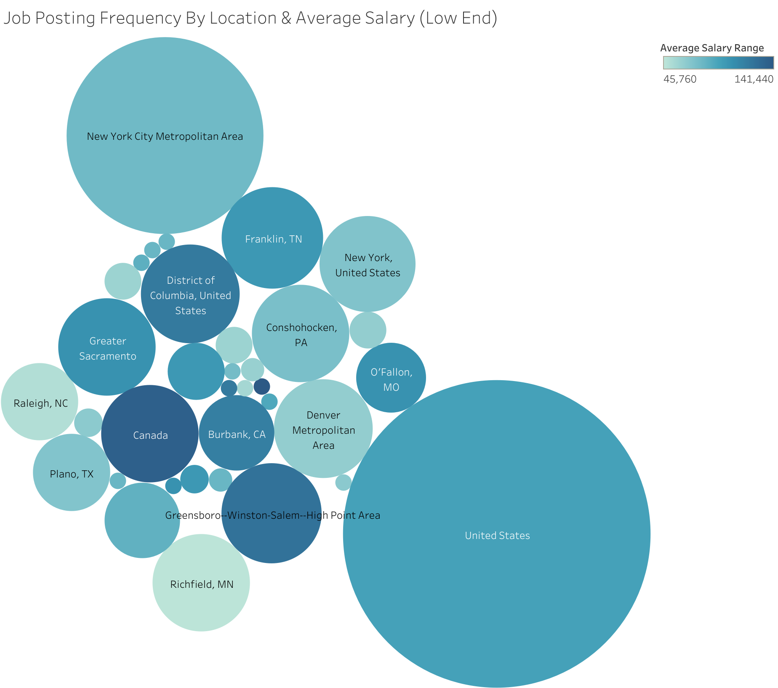
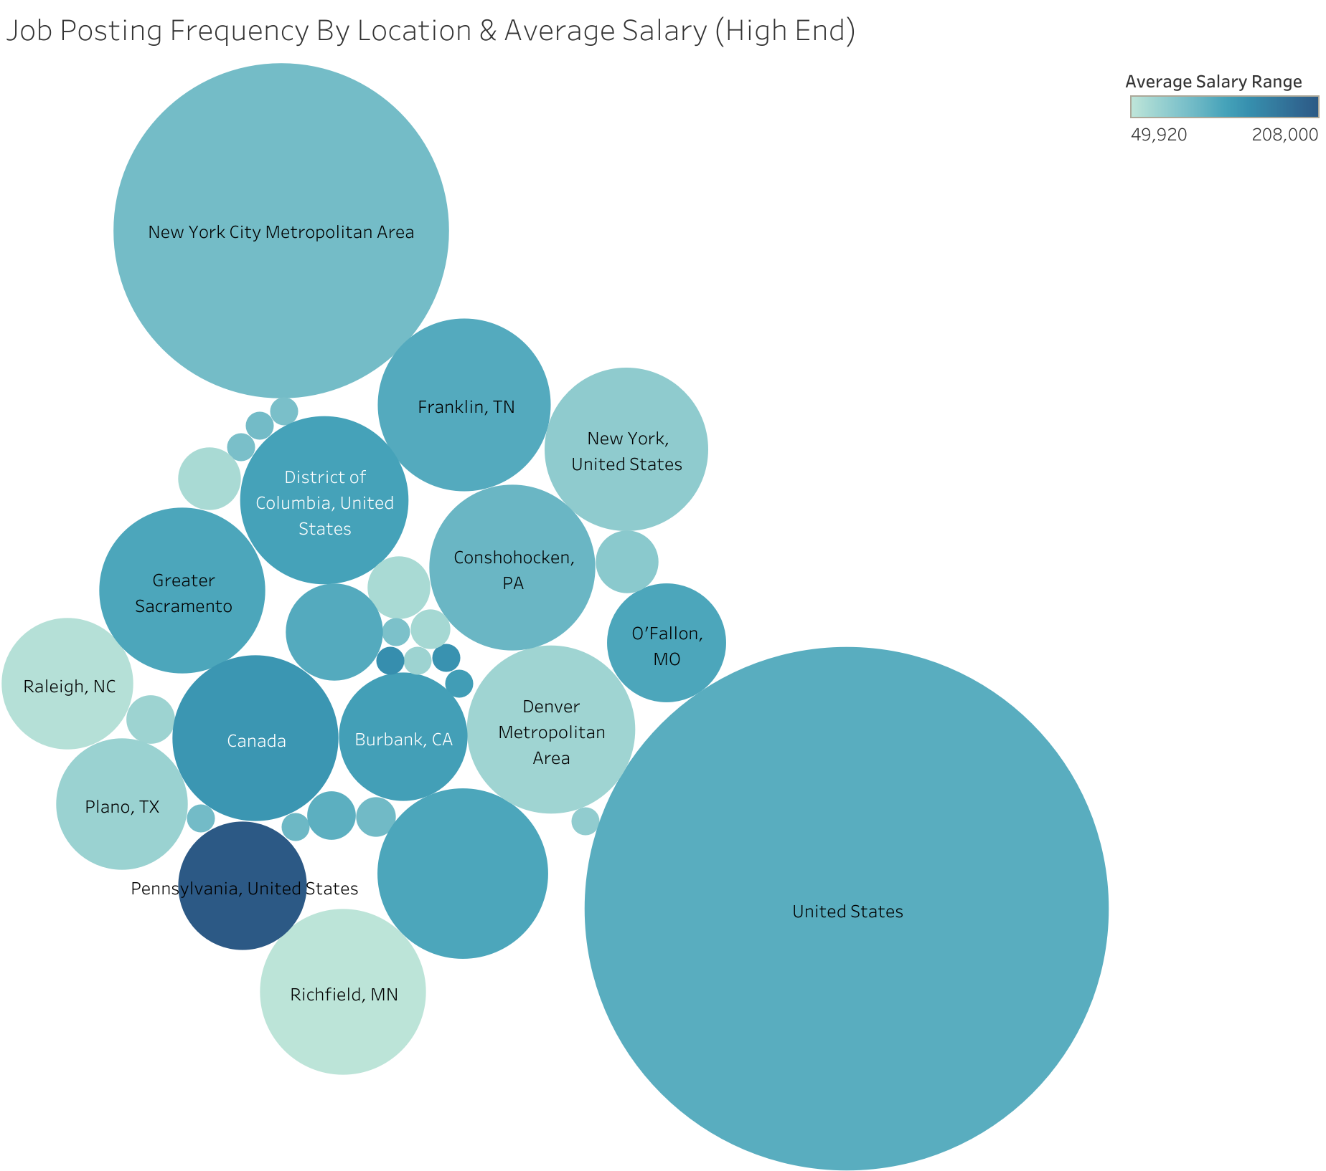
Combined Look At Location & Salary Information
Locations listed as “United States” and “Canada” referred to remote job types.

Slide 12
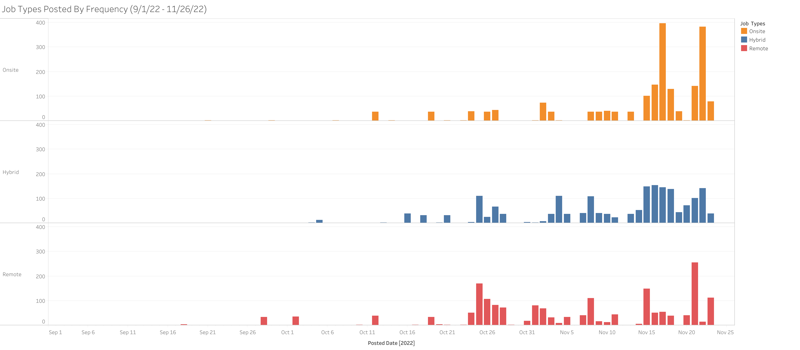
Trends Amongst Job Types Over Time
Onsite jobs had the largest increase in job postings towards the year’s end
End of October seemed to be a consistent starting point for job posting increase across all job types
Remote job postings have the greatest fluctuation over time

Slide 13
Thank You For Taking The Time To Check Out My Project

